Slide 1


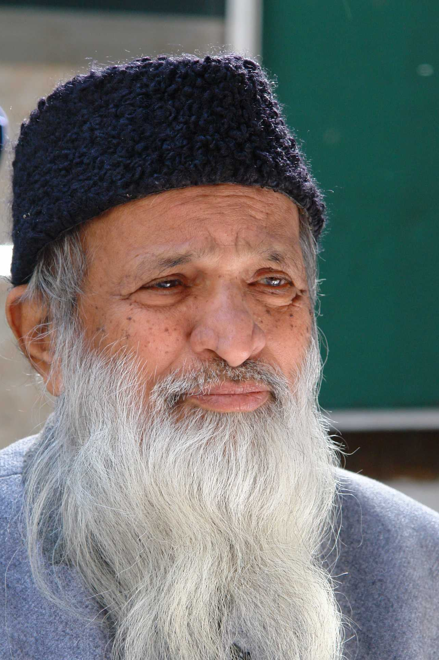
Abdul Sattar Edhi
Abdullah (02-131222-099)

Slide 2
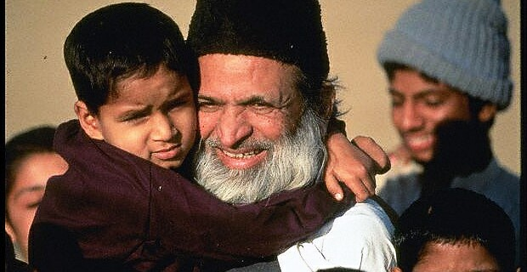
Who was Abdul Sattar Edhi?
Abdul Sattar Edhi was a renowned Pakistani philanthropist who is widely regarded as one of the greatest humanitarians in Pakistan's history. He was born on February 28, 1928, in Gujarat, British India, and passed away on July 8, 2016, in Karachi, Pakistan. He founded the Edhi Foundation, which runs the world's largest ambulance network, along with homeless shelters, animal shelters, rehabilitation centers, and orphanages across Pakistan. He is known amongst Pakistanis as the "Angel of Mercy" Abdul Sattar Edhi was a person who had a deep sense of empathy and kindness for the suffering of others. He gave away most of his wealth and possessions to help others. He never discriminated against anyone based on their religion, ethnicity, or nationality. He treated everyone with respect and dignity.
This Photo by Unknown Author is licensed under CC BY-NC-ND

Slide 3
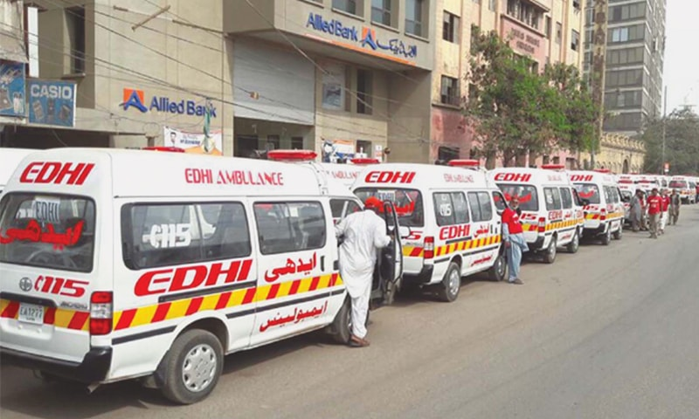
Career Highlights
Abdul Sattar Edhi started his career as a street hawker, selling pencils and matchboxes in Karachi, Pakistan. He then became a commission agent selling cloth in the wholesale market. After a few years, he left this occupation and decided to establish a free dispensary with the help of some members of his community and began providing emergency services to the people in need. His charitable activities expanded greatly in 1957 when an Asian flu epidemic (originating in China) swept through Pakistan and the rest of the world.
Over his lifetime, the Edhi Foundation expanded, backed entirely by private donations from Pakistani citizens across class, which included establishing a network of 1,800 ambulances. By the time of his death, Edhi was registered as a parent or guardian of nearly 20,000 adopted children.
He personally participated in many rescue and relief operations during natural disasters and wars, such as the 1970 Bhola cyclone, the 1974 famine in Ethiopia, the 1985 earthquake in Mexico, the 2005 earthquake in Pakistan, and the 2010 floods in Pakistan.
This Photo by Unknown Author is licensed under CC BY

Slide 4
Obstacles
He faced poverty and hardship as a young migrant in Karachi after the partition of India. He also faced hostility and discrimination from some members of his own community who did not approve of his social work.
He faced challenges in maintaining and expanding his foundation's services due to the lack of government support, corruption, bureaucracy, and security issues. He often had to sell his personal belongings or borrow money to keep his foundation running.
He faced opposition and threats from some religious extremists and political groups who accused him of being a heretic, a spy, or a traitor.He was also attacked several times by armed men who tried to rob or kidnap him or his staff. He survived a bomb blast near his office in 2013 that killed three people.

Slide 5
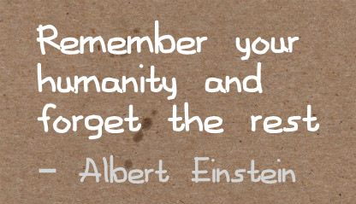
What inspired him?
His mother was his first inspiration who taught him to be kind and generous towards the poor and needy. She also gave him a small amount of money every day to help someone in need. She suffered from paralysis and mental illness for eight years before she died, which made him more compassionate towards the sick and disabled.
His wife Bilquis Edhi supported him in his mission and shared his vision. She was a nurse who joined his foundation as a volunteer and later became his partner in life and work. She helped him run the maternity homes, adoption centers, women's shelters, and nursing homes that catered to women and children. She also accompanied him on many rescue missions and relief operations. She was awarded the Mother Teresa Award for Social Justice in 2015 for her humanitarian work.
He believed that all human beings are equal and deserve respect and dignity regardless of their religion, caste, or creed. He followed the principle of "service to humanity is service to God" and considered himself a "practical Muslim". He said that he did not need any mosque or temple to pray; he prayed with his actions by helping others.
This Photo by Unknown Author is licensed under CC BY-NC-ND

Slide 6
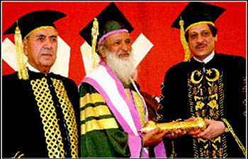
Achievements
He received many awards and honors for his humanitarian services, both nationally and internationally. Some of them are:
The Ramon Magsaysay Award for Public Service in 1986
The Nishan-e-Imtiaz in 1989
The Lenin Peace Prize in 1992
Wolf of Bhogio Peace Award (2005)
The Gandhi Peace Award in 2007
UNESCO-Madanjeet Singh Prize
He was also nominated several times for the Nobel Peace Prize.

Slide 7
Conclusion
Abdul Sattar Edhi lived a simple life and believed in selflessness. He dedicated his entire life to the service of humanity. He is a true hero and a role model for millions of people around the world.

Slide 8
Sources:
https://en.wikipedia.org/wiki/Abdul_Sattar_Edhi.
https://www.aljazeera.com/news/2017/2/28/14-things-to-know-about-abdul-sattar-edhi.
https://edhi.org/founder-profile/.
https://pantheon.world/profile/person/Abdul_Sattar_Edhi/.

